Slide 1


M.Tech Program
Advanced Industry Integrated Programs
Jointly offered by University and LTIMindTree
Review II
Project Title
FinSight: An Evidence-Grounded Financial Filing Analyst powered by Hybrid RAG
Team Member
Dhayanidhi R S
Knowledge partner | Implementation partner

Slide 2
FinSight: An Evidence-Grounded Financial Filing Analyst powered by Hybrid RAG
Introduction
Background & Problem Statement
Company financial filings contain valuable information across lengthy narratives, complex tables, financial statements, and notes. Analysts must manually search, interpret, compare, and verify this information.
Generic document-question-answering systems may:
    confuse fiscal periods, currencies, or presentation units.
    provide answers without precise source evidence.
Proposed System
FinSight combines full-document Hybrid RAG with a structured Financial Fact Ledger to:
    answer natural-language queries and comparisons.
    provide evidence-grounded answers with traceable citations.

Slide 3
FinSight: An Evidence-Grounded Financial Filing Analyst powered by Hybrid RAG
Objectives
Preserve every filing byte-for-byte with verifiable identity, and keep the original immutable
Extract a citable source representation — pages, blocks, tables and footnotes with exact coordinates
Retrieve passages by both wording and meaning, under scope filters that similarity cannot override
Generate answers in which every claim cites the stored source span it rests on
Verify every numeral against the span its own claim cites, and remove any claim that fails
Record every answer, decision and reason for audit.

Slide 4
FinSight: An Evidence-Grounded Financial Filing Analyst powered by Hybrid RAG
Module name
Intake & Storage: Validates untrusted uploads; stores originals content-addressed and immutable.
Extraction: PyMuPDF and Docling produce pages, blocks, tables, cells and footnotes with page coordinates.
Chunking: Structure-aware splitting into focused child passages and broader parent passages.
Indexing: Local embeddings and BM25 term weights written to Qdrant through a transactional outbox.
Retrieval: Keyword and dense search under hard filters, fused by reciprocal rank, reordered by a cross-encoder.
Generation: Schema-constrained model, citation resolution, Evidence Gate, one recorded decision per answer.
Surfaces: Authenticated REST API, Streamlit interface, operator command line.

Slide 5
FinSight: An Evidence-Grounded Financial Filing Analyst powered by Hybrid RAG
Methodology / Modeling Plan
Prepare the corpus (once per filing) Validate the file, preserve the original immutably, extract pages, blocks, tables and footnotes with coordinates, split into child units for matching and parent units for context, then index as dense vectors and BM25 term weights.
Retrieve (per question) Keyword and meaning search run together under hard scope filters, combined by reciprocal rank fusion, reordered by a cross-encoder, and de-duplicated so the same evidence is not counted twice.
Generate under constraint The model receives only the selected passages, labelled [1] [2] [3], and must reply in a fixed structure: claims plus the labels each claim rests on. It is instructed not to calculate, and permitted to say the passages do not answer.
Verify before release Code resolves every label back to the stored source text and checks that each figure, scale word and currency in a claim actually appears there. A claim that fails is removed; if nothing survives, the system abstains. Every answer is recorded with its decision and reasons.

Slide 6
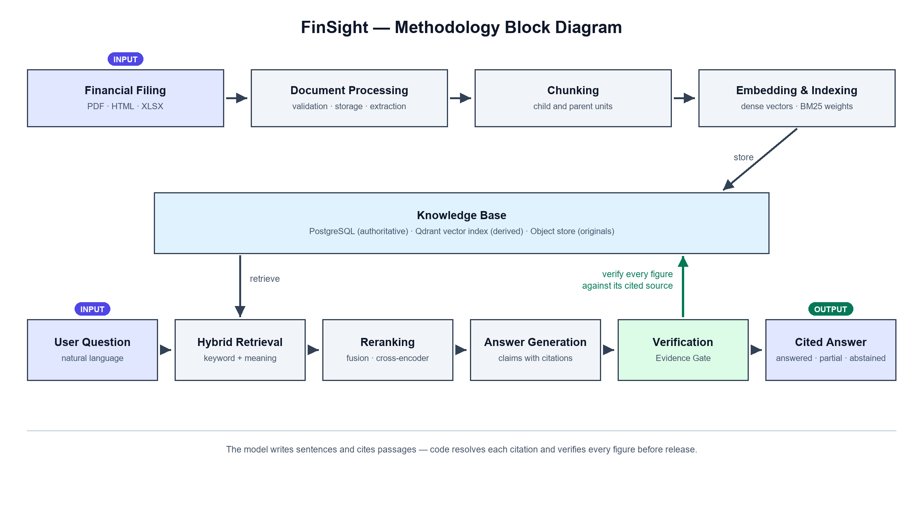
FinSight: An Evidence-Grounded Financial Filing Analyst powered by Hybrid RAG

Slide 7
FinSight: An Evidence-Grounded Financial Filing Analyst powered by Hybrid RAG
Data preprocessing & EDA
What Extraction produces?
Element type | Count
Narrative blocks | 40,476
Table cells (with header + row-label paths) | 23,613
Tables detected | 861 — 613 accepted, 248 rejected by the quality gate
Bound footnotes | 36 across 30 tables
Dropped: whitespace-only | 1,557
Withheld: contents-page leader lines | 129

Slide 8
FinSight: An Evidence-Grounded Financial Filing Analyst powered by Hybrid RAG
Data preprocessing & EDA
What EDA found?
Artefact | Before | After
Passages unreachable by a correctly-spelled query | 573 | 0
Chunks carrying a ligature | 441 of 5,637 | 0 of 5,628
Ligature elements (U+FB00–FB04) | 1,561 | 0
Non-breaking / thin spaces | 214 | 0
Invisible control characters | 127 | 0
Words split by a line-break hyphen | 874 | 1

Slide 9
FinSight: An Evidence-Grounded Financial Filing Analyst powered by Hybrid RAG
Data preprocessing & EDA
What Chunking produces?
Measure | Value
Chunks (parent + child) | 5,628
Retrieval children / parents | 4,859 / 769
Mean / max child tokens | 200 / 384
Children below the 48-token floor | 1,214 (25%) — an open item
Narrative / table-derived children | 3,605 / 1,254
Embedded vectors | 4,859 × 768-d

Slide 10
FinSight: An Evidence-Grounded Financial Filing Analyst powered by Hybrid RAG
Approach/Algorithms/Tools
Layer | Technology
Language | Python 3.12
Authoritative store | PostgreSQL, SQLAlchemy, Alembic
Vector Database & Indexing | Qdrant — dense + BM25 sparse
Object storage | SeaweedFS via the S3 protocol (boto3)
Embeddings | nomic-embed-text via Ollama, 768-dim
Generation | llama3.1:8b via Ollama, host-native
Reranking | ms-marco-MiniLM-L-6-v2 cross-encoder
Parsing & Extraction | PyMuPDF and Docling
API | FastAPI
Interface | Streamlit
Deployment | Docker Compose, single node

Slide 11
FinSight: An Evidence-Grounded Financial Filing Analyst powered by Hybrid RAG
Project plan/Milestone progress
# | Phase | Milestone | Status
1 | Foundation | Environment, toolchain and dependency set validated | Complete
2 | Persistence | PostgreSQL schema, Alembic migrations, bounded transactions | Complete
3 | Storage | S3-protocol object store, intake with hashing and type validation | Complete
4 | Extraction | Citable source representation; 5.2× persistence throughput improvement | Complete
5 | Corpus | 3 real filings ingested; development / held-out split frozen | Complete

Slide 12
FinSight: An Evidence-Grounded Financial Filing Analyst powered by Hybrid RAG
Project plan/Milestone progress
# | Phase | Milestone | Status
6 | Retrieval | Parent/child chunking, embedding, Qdrant dense + BM25 sparse index | Complete
7 | Hybrid search | RRF fusion, hard metadata filters, degradation path, QueryTrace | Complete
8 | Reranking | Cross-encoder admitted provisionally; latency and failure path measured | Complete
9 | Generation | Schema-constrained generation, citation resolution, Evidence Gate | Complete

Slide 13
FinSight: An Evidence-Grounded Financial Filing Analyst powered by Hybrid RAG
Project plan/Milestone progress
# | Phase | Milestone | Status
10 | Interfaces | REST API with token auth, Streamlit answer surface, library and trace views | Complete
11 | Data quality | Glyph normalisation (573 → 0) and content-keyed embedding cache | Complete
12 | Evaluation | Golden question set and Recall@k / MRR / nDCG harness | Planned
13 | Deployment | Containerised API and UI, worker tier, CI image builds | Planned

Slide 14
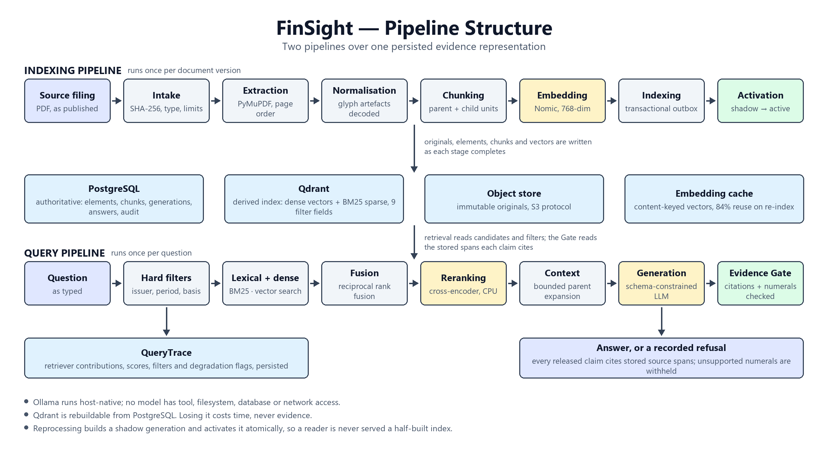
FinSight: An Evidence-Grounded Financial Filing Analyst powered by Hybrid RAG
Pipeline structure

